Slide 1
JAVA PROJECT
Lost and Found Item
Management System
Developed in Java | Console-based Application
Student Names: K. Sri Varshik Reddy , R. Varun Reddy
Roll Numbers: 2620030668,2620030634
Faculty Guide: V. Gopi Krishna Sir

Slide 2
1. Introduction
People often lose everyday items such as pens, books, bags and IDs, and others find them with no easy way to report it.
The Lost and Found Item Management System is a Java application that records lost and found items in one place.
Users can report an item, view all records and search by item name through a simple menu.
At a glance
Language: Java
Input: Scanner
Storage: ArrayList
Interface: Console menu
2

Slide 3
2. Problem Statement
Lost and found items are usually tracked through notice boards, word of mouth or messages.
There is no central record, so owners and finders rarely connect.
Manual methods are slow, unorganised and hard to search.
A simple digital system is needed to store item details and find them quickly.
3

Slide 4
3. Objectives
Report
Store
View
Search
Record lost and found items with name and location
Keep all item records in a single list
Display every reported item with its status
Find items quickly by name, ignoring case
4

Slide 5
4. Existing System
Manual registers and paper notices at offices, colleges and hostels.
Announcements and messages through word of mouth or social groups.
Drawbacks
Time consuming and error prone | No central database | Difficult to search | Low chance of recovering items
5

Slide 6
5. Proposed System
A menu-driven Java program that manages lost and found records digitally.
Simple
Organised
Easy numbered menu, no training needed
Each record stores name, location and status
Fast search
Reusable
Case-insensitive keyword search
Same method handles lost and found reports
6

Slide 7
6. System Architecture
User
Console Menu
Methods
Storage
Enters choice and details
>
do-while loop with switch-case
>
addItem(), viewItems(), searchItem()
>
ArrayList<String> items
Input flows from the user through the menu to the methods, which read and write the item list.
7

Slide 8
7. Functionalities
1. Report Lost Item
2. Report Found Item
3. View Items
Saves item name and location with status "Lost"
Saves item name and location with status "Found"
Lists all stored records
4. Search Item
5. Exit
Shows records matching the entered name
Ends the program with a thank you message
8

Slide 9
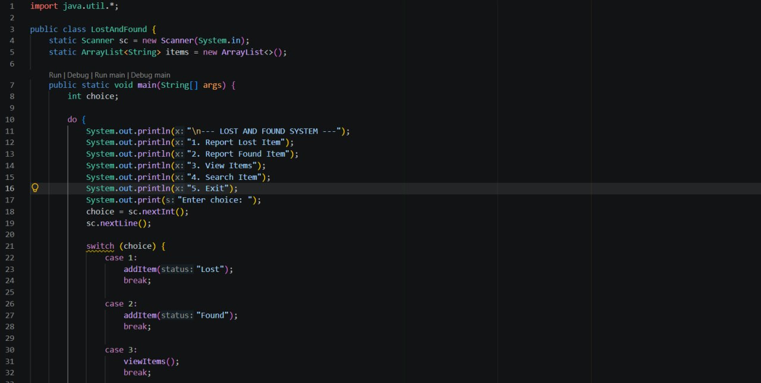
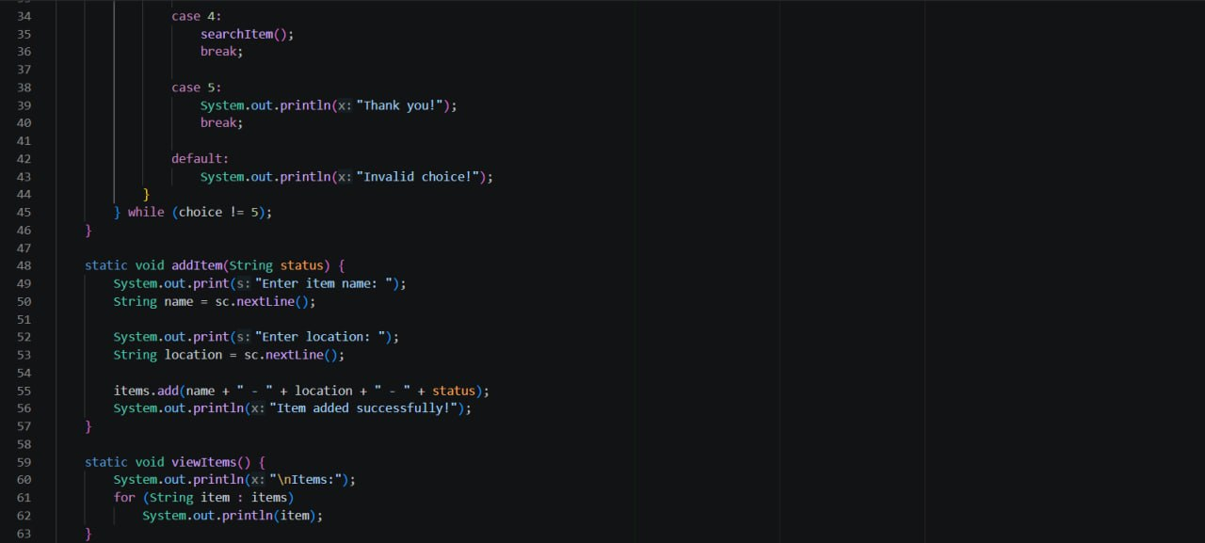
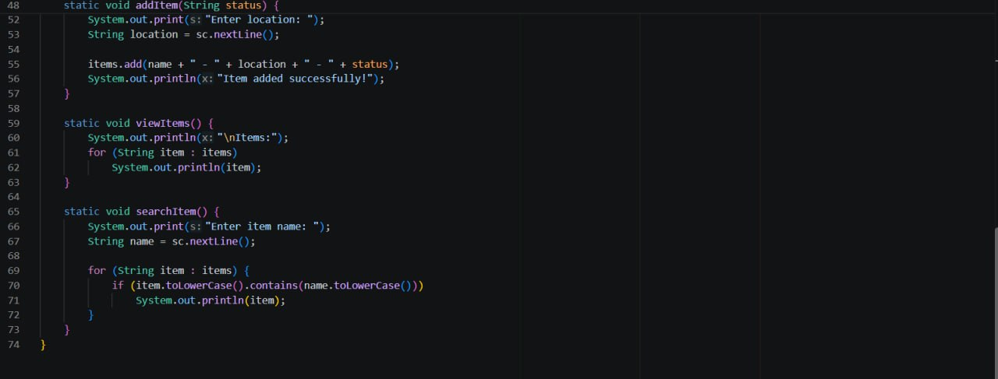
8. Implementation - Java Code
Code screenshot 1
(menu and main loop)
Code screenshot 2
(switch cases, addItem)
Code screenshot 3
(viewItems, searchItem)
9

Slide 10
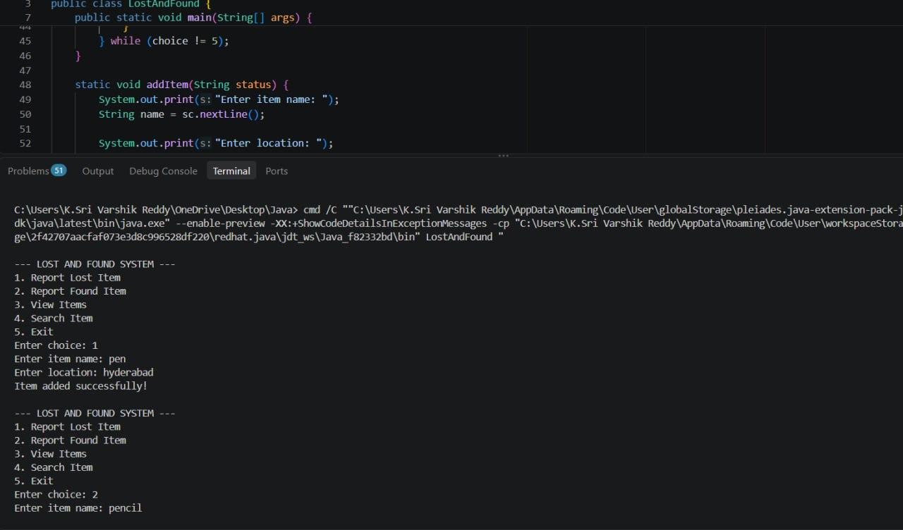
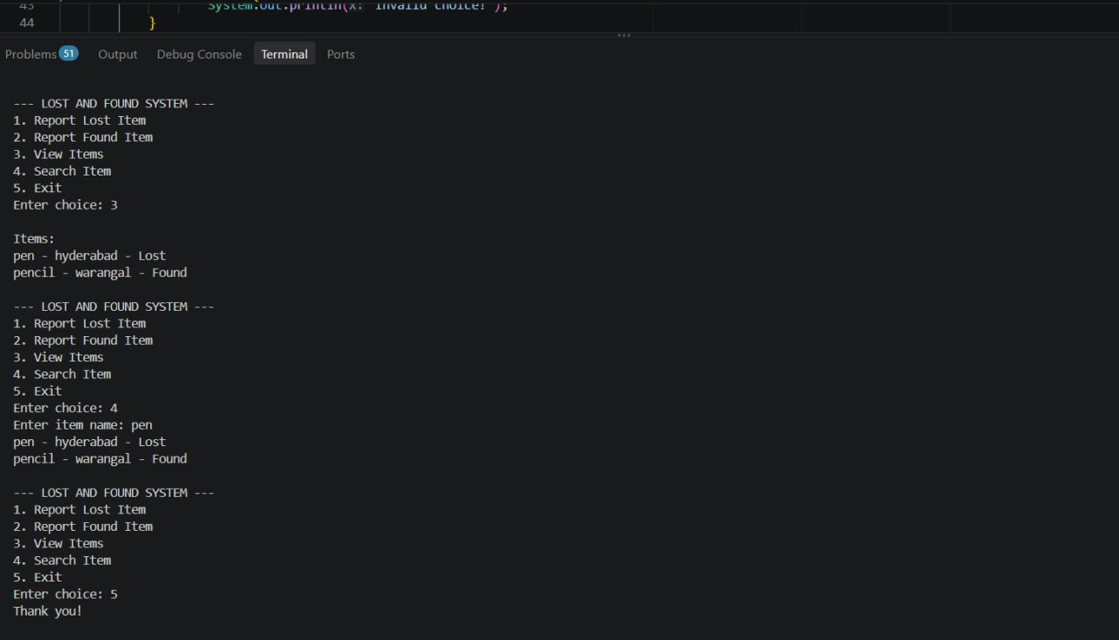
9. Output Screenshots
Output screenshot 1
(report items)
Output screenshot 2
(view, search, exit)
10

Slide 11
10. Future Scope
Database
GUI / Web / Mobile
Store data permanently with MySQL or files
Build a user-friendly interface
User Login
Alerts
Separate accounts for owners and finders
Email or SMS when a match is found
11

Slide 12
11. Conclusion
The system lets users report, view and search lost and found items from one menu.
It uses core Java concepts: Scanner, ArrayList, loops, switch-case and methods.
It replaces scattered manual tracking with a simple, organised record.
Future upgrades such as a database and GUI can make it a complete real-world solution.
12

Slide 13
Thank You
Questions?

